Slide 1
Land inequality and economic growth: a dynamic panel data approach
Ricardo Fort, 2007, Agricultural Economics
Presentation by Jessica Du
ECON 541

Slide 2
Background/ Literature Review
Relationship between inequality and economic growth
Literature has found that inequality is detrimental for growth
Smaller amount of literature has found a possible positive relationship
Political economy model vs. socio-political instability model
Political Economy model:
Inequality affects taxation through the political process- elect governments with redistributive policies or choose tax rate (Alesina and Rodrik, 1994; Persson and Tabellini, 1994)
Capital Market imperfections prevent poor from taking profitable investments- more equal wealth distribution can help overcome asset thresholds (Stiglitz, 1969; Aghion et. al, 1999).

Slide 3
Background/ Literature Review
Socio-political instability model
Focuses on role of social stability and property rights
Looks at impact on economic efficiency and how unequal distribution of assets can:
Affect cost of market exchange, incentives to invest, levels of violence, society’s ability to respond to shocks (Deininger and Olinto, 1999)
Create barriers that affect cost of social and economic interactions (Collier, 1998; Temple, 1998)
Affect growth through direct damage from violence and crime, cost of preventative measures and impact on property rights and investment measures (Bourguignon, 1998; Knack and Keefer, 1995)
Make property rights less secure and negatively affect growth by deterring investment and increasing transaction costs (Keefer and Knack, 2002; Rodrik, 2000; Byamugisha, 1999; Deininger et al., 2003; Lipton, 1974)

Slide 4
Background: Author’s Critiques
Most of literature:
Uses income inequality as explanatory variable as opposed to asset distribution
Argues that asset distribution better explains inequality and growth as compared to income inequality
Inequality in assets informs more about the implications of policies
Utilizes cross sectional evidence rather than panel data
May result in biased results due to the presence of country specific attributes (history, endowment factors)
Other authors that have used panel data include Forbes (2000) and Li and Zou (1998), found that negative relationship between inequality and growth weakens considerably and may actually be reversed
Author argues there is a theoretical gap : weak explanations for potential direct effects of asset inequality on growth, controlling for investment effect

Slide 5
Research Question
What is the relationship between assets distribution and economic growth?
What likely channels link asset and economic growth?
Property rights?
Land Ownership?
Education?

Slide 6
Data
Assembled new panel database
Observations for 30+ countries over the last 3 decades
Time varying variable for the Land Gini index
(previous studies only had time-invariant measurement)
Uses system general method of movements (GMM) estimator (Hansen, 1982).
GMM does not require complete knowledge of the distribution of the data
GMM is a general framework for deriving estimators, use assumptions about the moments of the random variables to derive an objective function.
Assumed movements of random variables provide population movement conditions
Finds parameters that make the sample moment conditions as true as possible

Slide 7
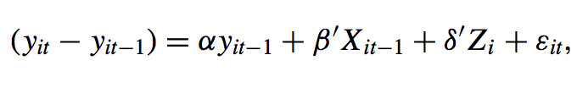
Methodology- OLS Estimation
Where:
Y_{it}= logarithm of per-capita GDP of country i in period t
X_{it −1} =vector of country-specific time-varying variables affecting growth
Z_{i} is a vector of country specific time-invariant variables
ε_{it} = error term, captures the effect of time-invariant and time-varying unobserved country characteristics
Can be divided in a country-specific time-invariant effect u_{i} and the time-variant disturbance e_{it}

Slide 8

Methodology- OLS Estimation
Assuming:
Cov(e_{it}, u_{i}) = 0 and Cov(e_{it}, e_{is}) = 0, for any t≠ s, then the equation becomes:
Author argues that OLS estimation is likely to be biased
Growth correlated with country specific effect
Variables in vector Z_{i} may be correlated with error term
To fix this: first differencing for left and right hand side variables but creates problems for fixed effects estimation
Uses GMM estimator
Due to lack of identification of time invariant variables with this transformation, GMM serves as unbiased instrumental variables estimator
Uses twice lagged y_{it} and X_{it} as instruments
Notes:
GMM basically uses 1970s data to estimate what might happen in 1980 and uses that to estimate what might happen in 1990.

Slide 9
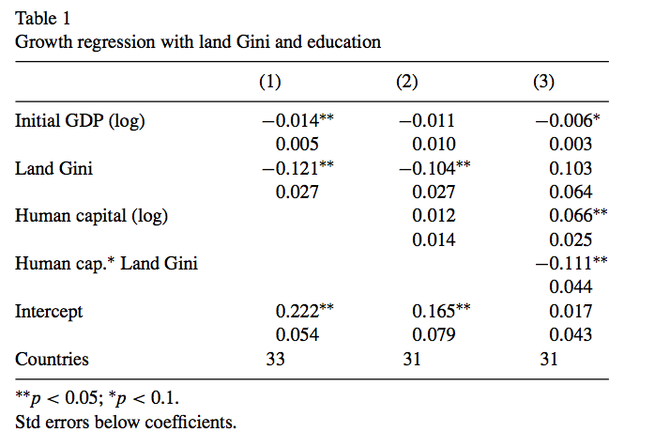
Findings
Notes:
Coefficient for the land Gini distribution is negative and significant, thus confirming the hypothesis that both the level and the change towards a more equal distribution of land have an important positive effect on the GDP growth of a country
column 3 is that once we include the interaction term between human capital and land distribution, the configuration of the inequality effect on growth changes dramatically. coefficient for land distribution is now positive but insignificant, the education effect becomes sig- nificant, and the interaction term is negative and significant.
hypothesis that even though human capital investments are very important for enhancing growth, countries with highly unequal levels of asset distribution tend to face a reduced effectiveness of their educational policies.

Slide 10
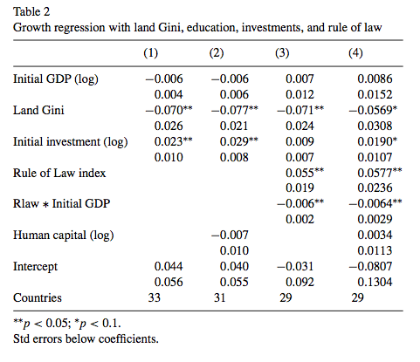
Findings
Notes:
Coefficient for the land Gini distribution is negative and significant, thus confirm- ing the hypothesis that both the level and the change towards a more equal distribution of land have an important positive effect on the GDP growth of a country
column 3 is that once we include the interaction term between human capital and land distribution, the configuration of the inequality effect on growth changes dramatically. coefficient for land distribution is now positive but insignificant, the education effect becomes sig- nificant, and the interaction term is negative and significant.
hypothesis that even though human capital investments are very important for enhancing growth, countries with highly unequal levels of asset distribution tend to face a reduced effectiveness of their educational policies.

Slide 11
Findings
Re: Main hypothesis- asset distribution is a major determinant of economic growth.
Land inequality creates a barrier to the effectiveness of educational policies
Including physical investments variable in the model corroborates the existence of a growth-reducing impact of land inequality that goes beyond the conventional channel of credit market imperfections and reduced investments
Security of property rights appears as an important factor to explain economic growth, its effect does not change the relationship between land inequality and growth

Slide 12
Policy Implications
Policies aiming at a more equal distribution of assets will be more effective if combined with complementary measures towards educational reforms and the improvement of institutional arrangements to secure property rights.
For developing countries that pursue market liberalization and privatization programs, try to make sure reforms don’t lead to the concentration of assets in few hands

Slide 13
Critique
Author developed own dataset of 30+ countries:
Almost half of the countries in the dataset were Western European countries
Limited representation in East Europe and Central Asia (only 1 country! Turkey) and the Middle East & N. Africa (Israel and Portugal (??))
Definition of “asset distribution” does not include housing or urban land ownership → this may seriously impact the findings, as the author excludes major assets of urban populations

